Slide 1
Introduction to the Module and ICA Briefing
Big Data and Business Intelligence

Slide 2


A bit about me…
2016 - Preparatory Classes Mathematics and Physics Degree in Alphonse Daudet, Nimes, France.
2019 - Master Degree in Software engineering, ENSIAS, Rabat & Research Associate – INRIA, Rennes, France.
2020-2024 - PhD in Computer Science, Teesside University, UK & Research associate in National Horizon Centre (NHC).
Jan 2023 – March 2024 - PTL in Computer Science, Teesside University.
March 2024, Lecturer in Computing & Games, Teesside University.

Slide 3





Teaching Team
Module Leader & Moderator
Dr Annalisa Occhipinti, Professor in Computer Science, SCEDT
Email: a.occhipinti@tees.ac.uk
Chaimaa Tarzi, Lecturer in Computing and Games, SCEDT
Email: c.tarzi@tees.ac.uk
Office Hours (IT1.13): TBC
Greig Building (4 on map)

Slide 4
Teaching Team
Dr Ogbo Bianca, Lecturer in Computer Science, SCEDT – Email: B.Ogbo@tees.ac.uk
Mansha Nawaz, Senior Lecturer in Computing & Games, SCEDT – Email: M.Nawaz@tees.ac.uk
Dr Chi Opara – Lecturer in Computer Science, SCEDT - Email C.Opara@tees.ac.uk
Dr Sumeia Elkazza – Lecturer in Computer Science, SCEDT – Email: S.Elkazza@tees.ac.uk
Le Minh Thao Doan – 3-year PhD student / Part-time Lecturer, SCEDT - Email: L.Doan@tees.ac.uk
Suraj Verma – 4-year PhD student / Part-time Lecturer, SCEDT - Email: S.Verma@tees.ac.uk
Nikita Huber Kralj – 1-year PhD student / Part-time Lecturer, SCEDT - Email: n.huber-kralj@tees.ac.uk
Haider, Abbas – Lecturer in Computer Science, SCEDT - Email a.haider@tees.ac.uk
Laeeq, Ammara – Part-time Lecturer, SCEDT - Email: A.Laeeq@tees.ac.uk
Nissy Mathews – Part-time Lecturer, SCEDT - Email: N.Mathews@tees.ac.uk
Kaveh Shahhosseini – 3-year PhD student / Part-time Lecturer, SCEDT - Email: K.Shahhosseini@tees.ac.uk
Thornton, Christopher – Lecturer in Computer Science, SCEDT - Email C.Thornton@tees.ac.uk﻿
See Blackboard for online materials: https://bb.tees.ac.uk/
School of Computing, Engineering & Digital Technologies

Slide 5
A few Important Info
Blackboard Module: Link

Slide 6
Today’s plan
Module Overview
Power BI Introduction and Demo
In-course assessment (ICA) Briefing

Slide 7

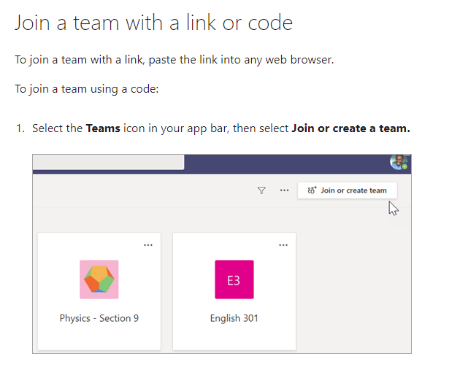
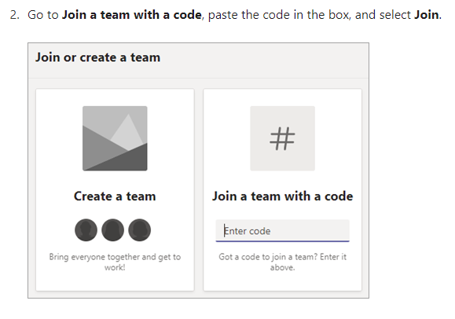
Join the Module’s Team
Join the Team using the code: 4o919wm
Link to how to join a Team using a code video

Slide 8
Module Overview

Slide 9








The world of data is changing
10x increase every five years
Big
Data
New Technologies Required
4.3 connected devices per adult
85% from new data types
27%
using social media input
“Organizations that build a modern information management system will outperform their peers financially by 20 percent.”
– Gartner, Mark Beyer., “Information Management in the 21st Century”
Notes:
Big Data – the size, type, shape of data that business are analyze is changing.
Data from sensors: RFID tags in manufacturing, or location data for company’s with large fleets.
Data from social media like facebook, twitter, Linked-In – for analyzing the success of a marketing campaign or to assess customer sentiment or to gather feedback to help shape products or services.
Public data – traffic or weather feeds, or data published from data.gov initiatives etc
Being able to easily tap into these data sources from smarter analytics to drive business insight is a prevalent theme.
Consumerization of IT – this is about choice. I as an individual want to work on the device of my choice. From wherever I want to work. This extends beyond devices to include apps and user experiences. I search for information all the time at home on the web, I want to have that same experience at the office. I’ll talk today about how we’re bringing these experiences to the world of data as well.

Slide 10
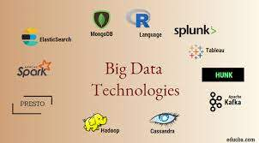

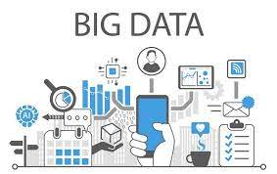

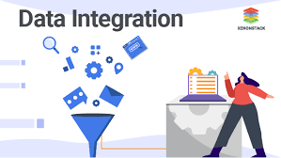
Module Aims
Examine Big Data technology platforms beyond the data warehouse
Investigate how to analyse un-modelled, multi-structured data
Explore how Big Data creates several new types of analytical workload
Explore how Big Data can deliver business value.
Explore how to integrate Big Data with traditional data warehouses and BI systems
Notes:
Collaborate and stay connected with Office 365: Extends Self-Service BI with ease of collaboration and sharing of reports and data sets which reducing friction from deployment and adoption.
Power BI Sites – quickly create collaborative BI sites for your team to share reports. Larger workbook viewing is now supported (up to 250MB) so that users can view and interact with larger workbooks through the browser. Power BI sites provide a highly visual experience for sharing reports including live report tiles to ease in locate the right report quickly.

Slide 11
Approach to Teaching
Each session will consist of one lecture\seminar (1 hour) and a practical session (2 hours).
You will be required to do work outside the class-time.
Bring pen, paper to each lesson.
Even more…
You must attend all lectures, seminars and labs.
You must ensure you complete the practical work every week by working between class\sessions.
This module is fundamental to your career and will form the basis of most job interviews.

Slide 12

Module Content
Business Intelligence modelling techniques
BI modelling techniques
Notes:
https://www.algoworks.com/business-intelligence/

Slide 13
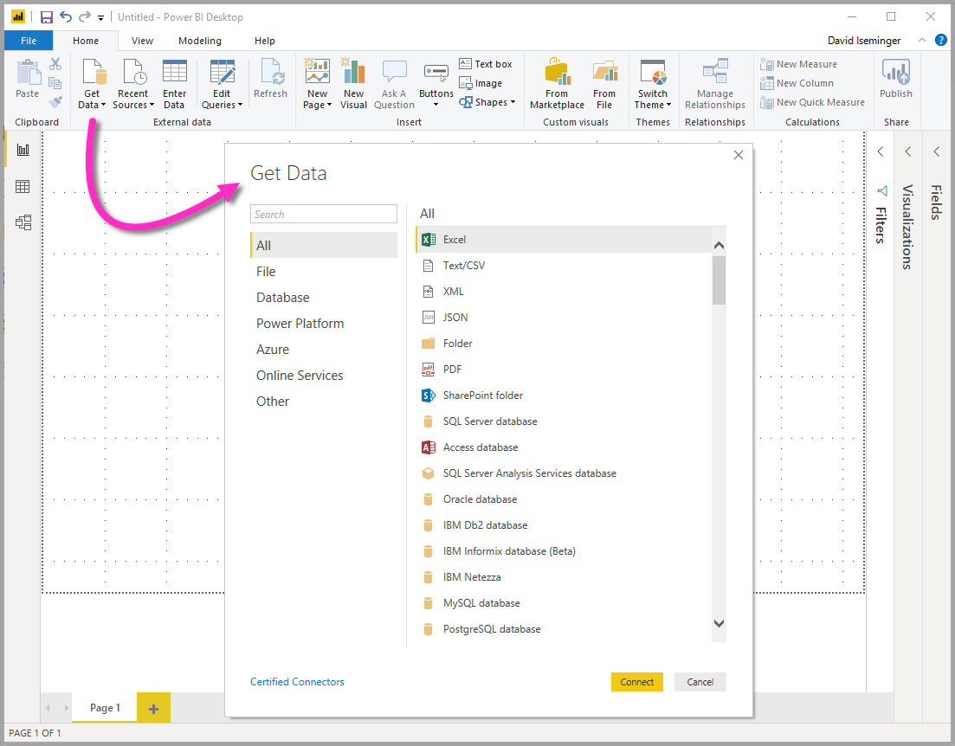
Module Content
Integrating data
BI modelling techniques
Data Integration and Modelling

Slide 14
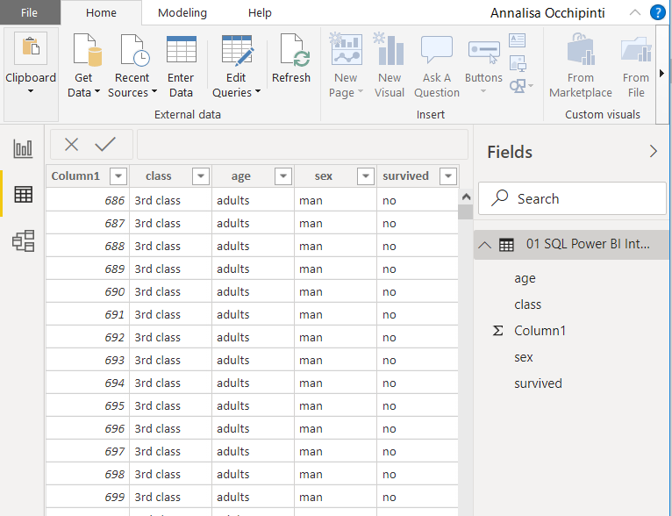
Module Content
Data Analytics
BI modelling techniques
Data Integration and Modelling
Data Analytics

Slide 15
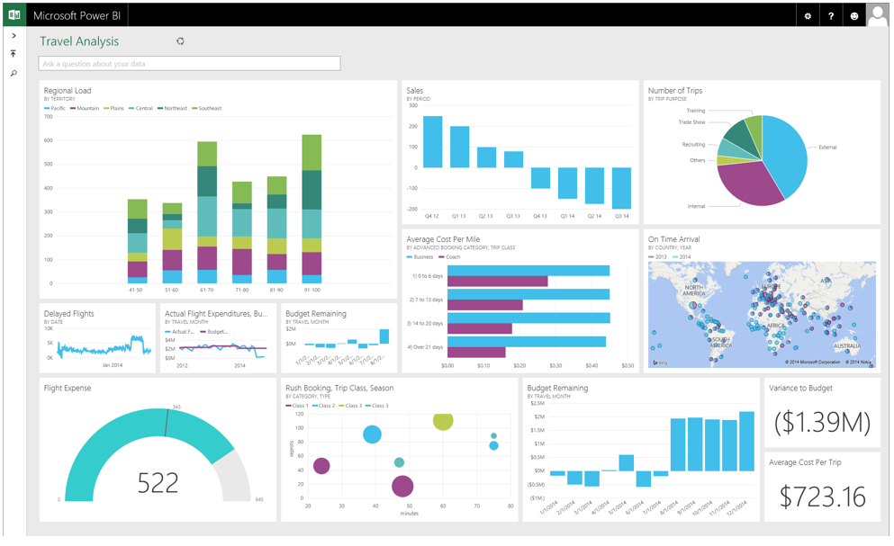
Module Content
Design a report
BI modelling techniques
Data Integration and Modelling
Data Analytics
Design a report

Slide 16

Module Content
Publish report
BI modelling techniques
Data Integration and Modelling
Data Analytics
Design a report
Publish a report

Slide 17
Module Indicative Content
Data Modelling and Analytics.
Analysing real world scenarios to perform data analytics in Power BI.
Examine how data analysis tools can be used to create data models for business analytics and decision support.
Create calculated columns, measures, and Key Performance Indicators that help users analyse critical business metrics.
Design a report
Build a Power BI dashboard using interactive visualizations and business intelligence capabilities with an interface simple enough for end-users to deploy their own reports and dashboards.
Publish report using Power BI Service.
Examining how data reporting is used to create, deploy, and manage mobile and paginated reports by utilising the range of ready-to-use tools and services provided in Power BI.
Business Intelligence modelling techniques.
Strategies for breaking down complexity and mapping real world objects to physical data using Power BI.
Investigating the best strategies for developing a business intelligence solution.
Integrating data.
Connecting different data sources to merge, transform and analysing data in Power BI.
Examine how to extract, transform and load (ETL) data to support business intelligence solutions.

Slide 18
Schedule
Week | Lecture (1hour) – Lab Session (2hours)
Week 1 | Introduction to Power BI and ICA Briefing
Week 2 | Introduction to Business Intelligence and Big Data
Week 3 | Data Modelling and Relationships in Power BI
Week 4 | Data Analytics and Big Data
Week 5 | Business Intelligence Solutions using DAX expressions
Week 6 | M-Language formula and data analytics
Week 7 | Creating a Business Report
Week 8 | Using Infographics and adding data analytics tools to a BI report
Week 9 | Animated Charts and KPI
Week 10 | Publishing reports to Power BI Service
Week 11 | Artificial Intelligence and Machine Learning Applications in Power BI and ICA Support
Week 12 | ICA Support
Week 13 | ICA Submission – Check date on Blackboard
Note: The schedule may be adjusted based on class progress.

Slide 19
What do you need to do?
Ask questions (feel free to interrupt me if you need any clarification);
Interact and be active in your learning (Learning is not a spectator sport!);
Take responsibility for your learning;
Solve all exercises (lectures and labs);
Do extra work (read recommended books, etc);
Respect everyone else.
Anything bothering you? Struggling? Get in touch with me!

Slide 20
Assessment - ICA
In course Assessment (ICA)
The assessment will be in the form of an in-course assignment (ICA) that requires students to design and implement a Data Warehouse/Business Intelligence solution using an appropriate dataset.
Along with the solution, students will prepare a technical report (approx. 1,200 words) that will include a summary of the solution (design and implementation).

Slide 21
Reading list
Books (available online from the library’s website)
Richterich, A., 2018. The big data agenda: Data ethics and critical data studies (p. 154). University of Westminster Press.
Eletronic Resources
Power BI, Microsoft https://powerbi.microsoft.com/en-us/
Power BI, get started https://docs.microsoft.com/en-gb/learn/modules/get-started-with-power-bi/
Power BI, guided learning https://docs.microsoft.com/en-us/power-bi/guided-learning/
Power BI, user group https://www.pbiusergroup.com/home

Slide 22
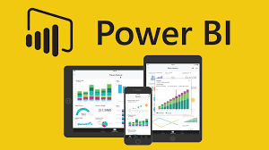
Power BI - Introduction

Slide 23

Unlock insights on any data
Lists become Analytical Visuals
Power BI
Data Analytics and Data Visualisation
Turning data into a business advantage
KPIs for BI

Slide 24

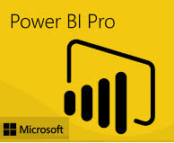








Power BI: connectivity to SAP BusinessObjects BI Where PowerBI tools meet trusted ‘enterprise data’ from Databases or Data Warehouse.
Single version of truth
Excel
Power BI
Instant productivity
Optimized business performance
SAP BusinessObjects BI
Notes:
Talking Points:
[Click]
Microsoft and SAP have recognized an opportunity for helping our customers reimagine their businesses that stretches across the data chasm.
[Click]
It begins in Microsoft Excel and Power BI for Office 365…
[Click]
and stretches across to SAP BusinessObjects.
[Click]
Today, we are excited to announce the public preview of Power BI connectivity to SAP BusinessObjects BI, a joint business intelligence interoperability solution. With this new solution, users can now seamlessly connect to SAP BusinessObjects BI Universes as another supported data source in Power Query for Excel, enabling them to access and analyze data across the enterprise and share their data and insights in the cloud and any device through Power BI.
Users can rely on the latest, most accurate, and trusted enterprise data directly in Excel through an SAP BusinessObjects BI Universe without having to wrestle with copying and pasting or manually importing data. Companies that have made investments in both BI stacks can now effectively leverage their technology investments to maximize ROI. IT can use the connectivity to continue to manage critical company data sources while giving business users access to trusted enterprise data in familiar tools they use every day without requiring them to learn new skills.
Multiple large joint customers are already using the preview today and experiencing the benefits created through the interoperability. They require this connectivity to ensure business users can bring trusted enterprise data from SAP BusinessObjects BI Universes into the familiar and powerful user experience of Microsoft Excel.
[Click]
The connectivity promotes a single version of truth with the ability to access and analyze source data reliably. Consistent data in both stacks. Access TO latest, accurate, trusted data. Familiar business friendly Data Semantics.
[Click]
Users become instantly more productive using familiar tools with trusted enterprise data at their fingertips. FAMILIAR TOOLS, TRUSTED ENTERPRISE DATA. NO HASSLE DATA REFRESH. EASY, SIMPLE, AND WELL INTEGRATED TO EXISTING WORKFLOWS.
[Click]
LEVERAGE EXISTING INVESTMENTS. IMPROVED PROFITABILITY FROM FASTER, BETTER, MORE TIMELY DECISIONS. CREATE INFORMATION DRIVEN CULTURE THROUGH BROADER BI REACH

Slide 25


Power BI: A powerful new way to work with data
Self-service business intelligence and analytics with Excel and the power of the cloud
Analyze in Excel
1 Billion Office Users
Collaborate in Power BI for Office 365
1 in 4 enterprise customers on Office 365
Discover
Analyze
Visualize
Share
Question
Mobility
Q&A
Scalable | Manageable | Trusted
Notes:
Microsoft Approach: (as well as other universities … only focus on Excel - PowerBI
Excel is the most commonly used analytical tool for business users – it truly is accessible to anyone. No other vendor has the ability to reach a billion users through tools they already know and use. Today Excel delivers end-to-end self-service BI functionality through capabilities such as Power Query, Power Pivot, Power View and Power Map. With the accessibility of Excel and proliferation of Office 365, we can lower the barrier of entry for businesses who want to take advantage of the benefits of business intelligence by putting the right analytics tools in everyone’s hands with no friction.
Ease of deployment through Office 365.. Power BI dramatically simplifies and reduces the time it takes for IT to setup and manage the complex infrastructure needed for an enterprise wide BI platform. Power BI enables businesses to balance between the needs of business users working in Excel and an IT department’s requirements for agility, monitoring and governance. IT can also provide business users the ability to search and access IT sanctioned corporate data sources both on premises and in the cloud while monitoring query usage against their data.

Slide 26
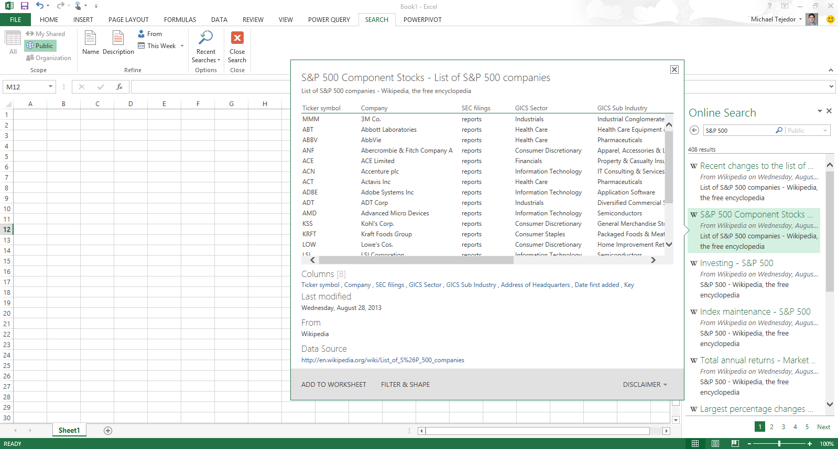
Industry Norm: Analyzing data with Excel
Easily discover and access public and corporate data
Discover
Analyze
Visualize
Explore
Notes:
Business intelligence as it is understood today is said to have evolved from the decision support systems (DSS) and developed throughout the mid-1980s.
The first general viable tool and techniques to support industry was Microsoft Excel and by 2010 decade saw the introduction of …
Powerful Self-Service BI in Excel 2013: We are taking our most powerful business intelligence solutions and building them directly into Excel.
There has never been such an abundance of available and useful information as there is today both across the web and across your organization. However, users are challenged with effectively discovering and connecting to this information so that they can gain the insights they need.
Power Query enables information workers with a familiar and intuitive experience for finding and connect to data from within Excel. Providing them with ease of combining and transforming this data so that it can be analyzed and visualized for deeper insight. Power Query supports a wide variety of data sources including relational, structured and semi-structured data, OData, data from the Web, Hadoop, as well as Data Search capabilities that provide users with a search experience for data, returning relevant data sets from across the enterprise and from external sources.

Slide 27
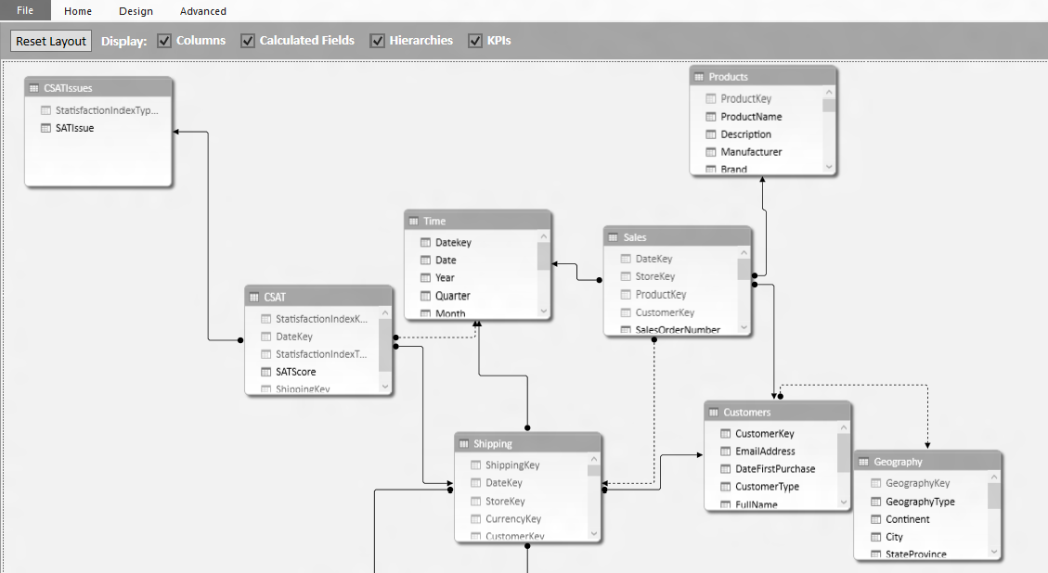
Industry Norm: Analyzing data with Excel
Model & analyze 100’s of millions of rows of data
Discover
Analyze
Visualize
Explore
Notes:
Power Pivot allows Excel users continue to create sophisticated models with data in Excel by creating relationships, custom measures and calculations, hierarchies, and KPI’s. Power Pivot models process data in-memory so that users can analyze 100’s of millions of rows of data with lightning fast performance. Power Pivot also compresses the data to reduce file sizes.

Slide 28
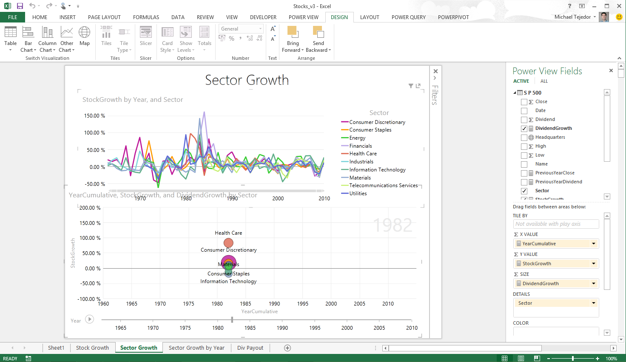
Industry Norm: Analyzing data with Excel
Explore your data with interactive visualization
Discover
Analyze
Visualize
Explore
Notes:
In Excel 2013 we also introduced a host of new visual capabilitie. Quick Analysis provided immediate views of various visualization options and reduced the time to add them on your data, Chart Recommendations used intelligent heuristics to suggest charts. The charting functionality provided live preview, richer data labels, and easier ways to add chart elements, apply styles, and filter directly from the charts.
Excel 2013 also introduced Power View, and with it brought beautiful interactivity to visualizations and more fluid exploration capabilities.
Power View easily creates visual reports and analytical views through interactive charts and graphs that help you explore and present your data in bold new ways in Excel. Customers can create dashboards of interactive visualizations that provide instant answers to variety of questions. This capability has resonated well with our customers, one of whom mentioned the rigidity of static snapshots during meetings has been replaced by the “Power View lifestyle”, their term for the transformational way of presenting and using information.

Slide 29
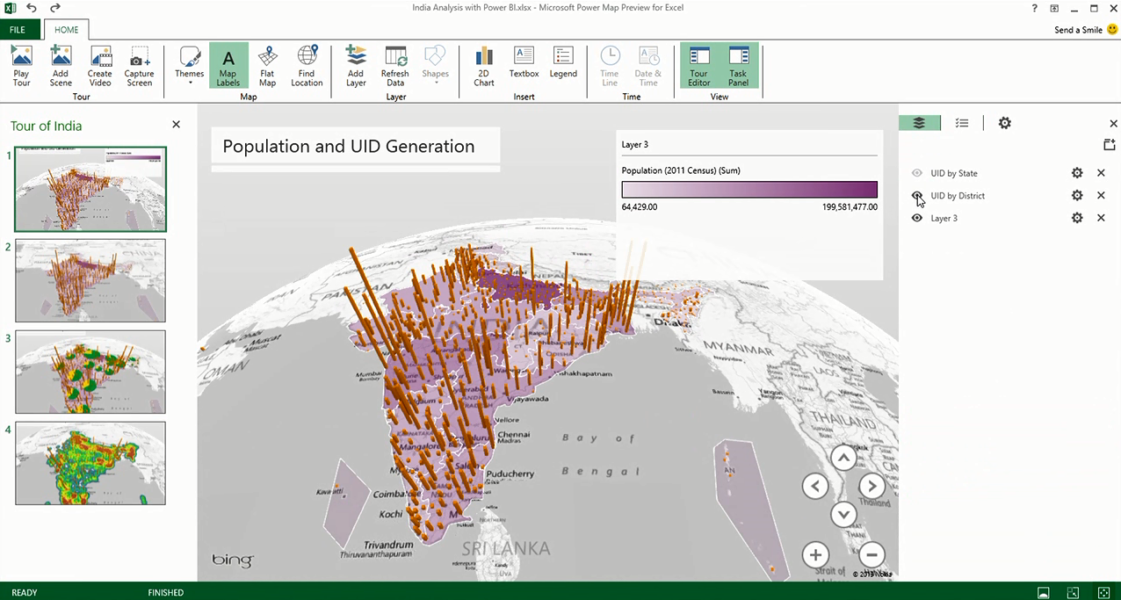
Industry Norm: Analyzing data with Excel
Uncover new insights with 3D geospatial analysis
Discover
Analyze
Visualize
Explore
Notes:
2019: Increasingly, we have access to geospatial data, and recently introduced Power Map brings new 3D visualization tool for mapping, exploring, and interacting with geographical and temporal data to Excel, enabling people to discover and share new insights such as trends, patterns, and outliers in their data over time. In addition, with Power Map, users can easily capture and distribute their insights in the form of an interactive movie, telling compelling stories about their data.
Inspiration for Power Map came from Microsoft Research’s WorldWide Telescope project. Launched in 2008, WorldWide Telescope is used by the astronomy community to visualize imagery and data, essentially giving astronomers an observatory in a PC.
What’s Next?
The importance for data visualization is on the rise. Deeper interactivity that blend analysis and visualizations even more fluidly, newer types of visualizations that enable you to see deeper insights more easily, richer experiences on the devices customers use most, and great storytelling experiences are just a few of the areas we’re investing in to make sure Excel remains the data productivity app of choice as our customer needs evolve.

Slide 30
A powerful new way to work with data
Self-service business intelligence with familiar Excel and the power of the cloud
Analyze in Excel
1 Billion Office Users
Collaborate in Power BI for Office 365
1 in 4 enterprise customers on Office 365
Discover
Analyze
Visualize
Share
Question
Mobility
Q&A
Scalable | Manageable | Trusted
Notes:
2014: Power BI for Office 365 is a complete self-service BI solution delivered through Excel and Office 365 that provides data discovery, analysis, and visualization capabilities to identify deeper business insights from data in Excel. The Power BI for Office 365 service is a cloud-based solution that enable collaboration and reduces the barriers to deploying a BI environment for sharing reports and accessing information.

Slide 31
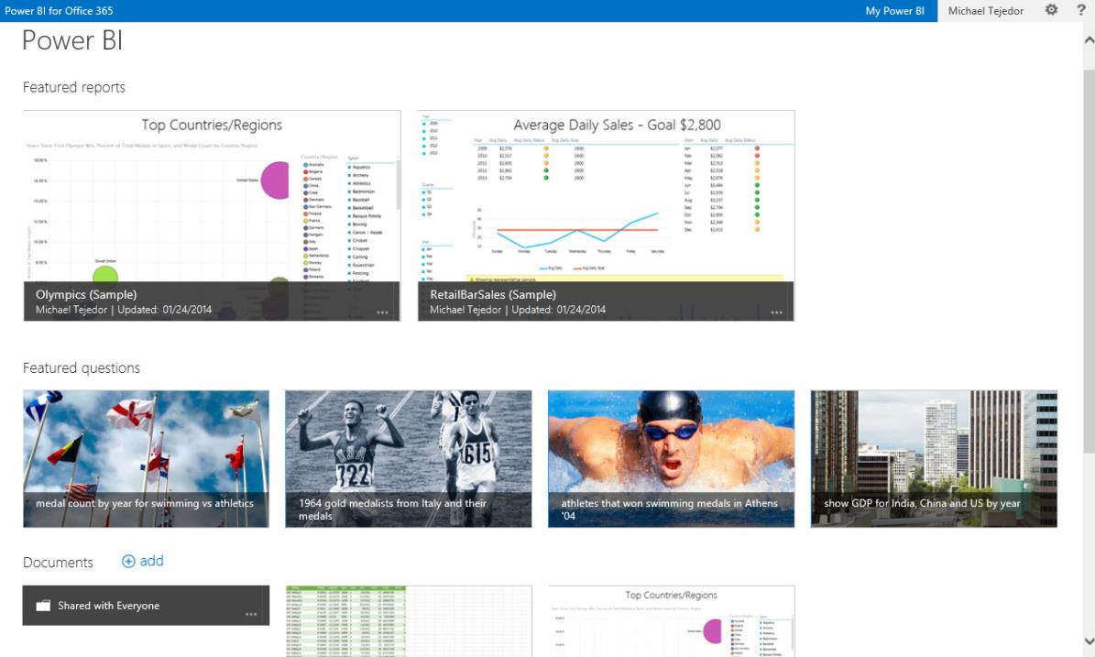
Share & collaborate with Power BI
BI Sites
Quickly create collaborative BI sites
Shared Queries
Data Refresh
Data Search
Mobile Access
Natural Language Questions
Notes:
Collaborate and stay connected with Office 365: Extends Self-Service BI with ease of collaboration and sharing of reports and data sets which reducing friction from deployment and adoption.
Power BI Sites – quickly create collaborative BI sites for your team to share reports. Larger workbook viewing is now supported (up to 250MB) so that users can view and interact with larger workbooks through the browser. Power BI sites provide a highly visual experience for sharing reports including live report tiles to ease in locate the right report quickly.

Slide 32
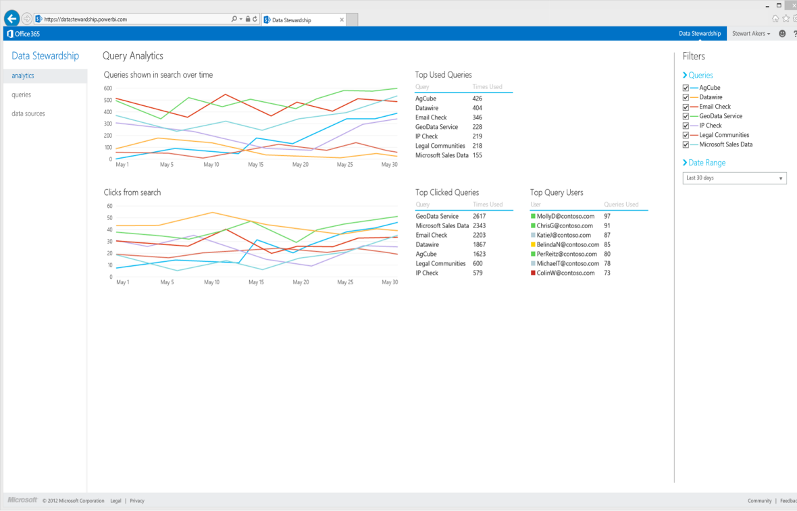
Share & collaborate with Power BI
BI Sites
Manage data queries for the team
Shared Queries
Data Refresh
Data Search
Mobile Access
Natural Language Questions
Notes:
Manage data queries for the team
With Power BI people can share not only workbooks but also the queries they create using Power Query in Excel. This allows members of the team to build and manage data queries for others to use when creating their own reports.
Once published to Power BI users can define who they want to share their data queries with and track who’s accessing which queries. Data queries are registered with the Data Catalog so that they can be easily discovered through data search in Excel. If a user tries to access a query but they do not have access to the underlying data source, a workflow will allow them to request access from the DBA responsible for the data.

Slide 33
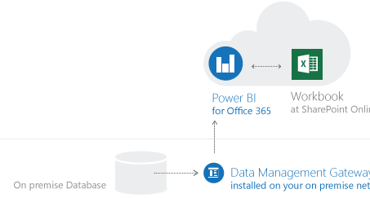
Share & collaborate with Power BI
BI Sites
Keep reports up to date with scheduled data refresh
Shared Queries
Data Refresh
Data Search
Power BI for Office 365
Workbook
Cloud
Mobile Access
On Premise
Data Management Gateway
Installed on-premises
Natural Language Questions
Notes:
Keep reports up to date with data refresh
A cloud based Business Intelligence solution must enable you to keep your reports connected to your on-premises data to keep their data fresh.
Keep your reports up to date by scheduling when the data should refresh. The Data Management Gateway allows reports that have been saved to the cloud to connect back to on-premises data sources to refresh data.
Scheduled data refresh for your reports
Connect cloud based report to on-premises data
The data management gateway is installed and configured by IT on-premises, and enables reports to connect through the firewall back to their underlying data sources.

Slide 34
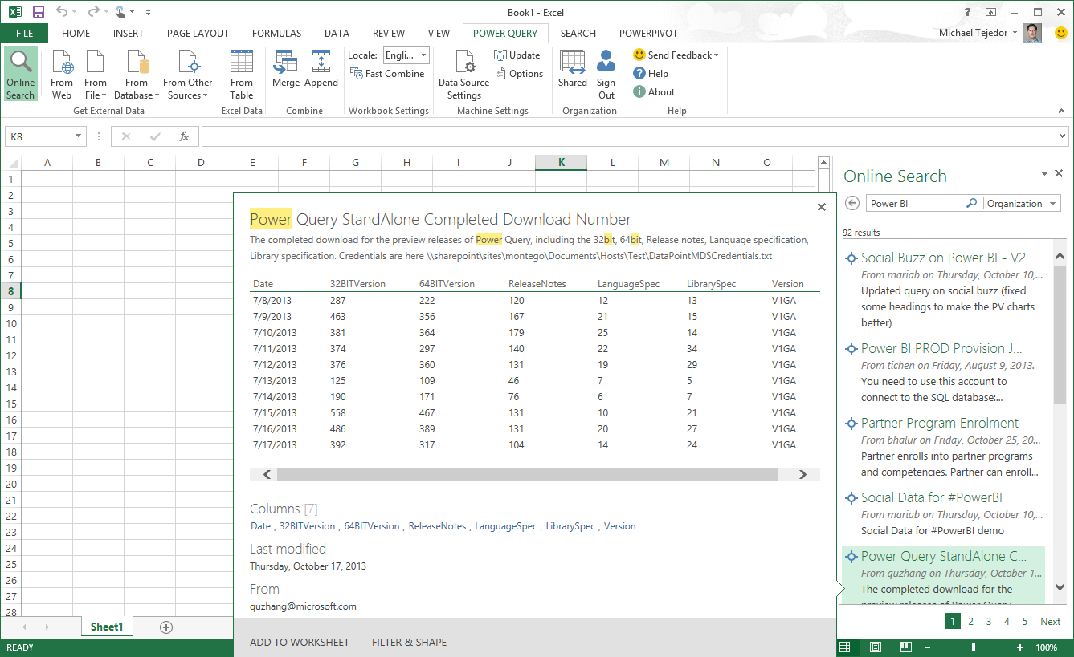
Share & collaborate with Power BI
BI Sites
Maintain a data catalog of searchable data
Shared Queries
Data Refresh
Search for:
Public Data
Corporate Data
Shared Queries
Data Search
Mobile Access
Natural Language Questions
Notes:
Maintain a Data Catalog of searchable data
IT departments can now use the Data Catalog feature of Power BI to make it easier for everyone to find and connect to corporate data.
The Data Catalog is a feature of Power BI which serves as a search engine for data, the IT department can register data from across the organization with the Data Catalog. This data is then searchable from within Power Query in Excel so that users can easily find and connect to corporate data they need without having to call IT with one off data requests.
When searching for data from Excel, users will now receive results from public data sources, corporate data sources managed by IT, as well as data queries that colleagues are publishing into Power BI. Making it easier to discover what connect exists and reducing duplicative efforts across the organization.
The Data Catalog also tracks data access and usage across the organization, providing IT with better telemetry for data governance and resource allocation.

Slide 35
Share & collaborate with Power BI
BI Sites
Stay connected with mobile access to your reports
Shared Queries
Data Refresh
Data Search
Mobile Access
Natural Language Questions
Notes:
Stay connected with mobile access to your reports
Mobile BI access to reports in Office 365 is provided through two mechanisms. First, Excel and Power View reports now render in HTML5 so that you can access these reports from any HTML5 compatible browser, on any device. The second, is through native mobile BI apps connect to the Power BI service to keep users connected to their favorite reports, which they can view and explore from their tablet devices. Windows 8.1 tablet devices will be supported are currently supported and iOS will be supported in H2 of CY2014.

Slide 36
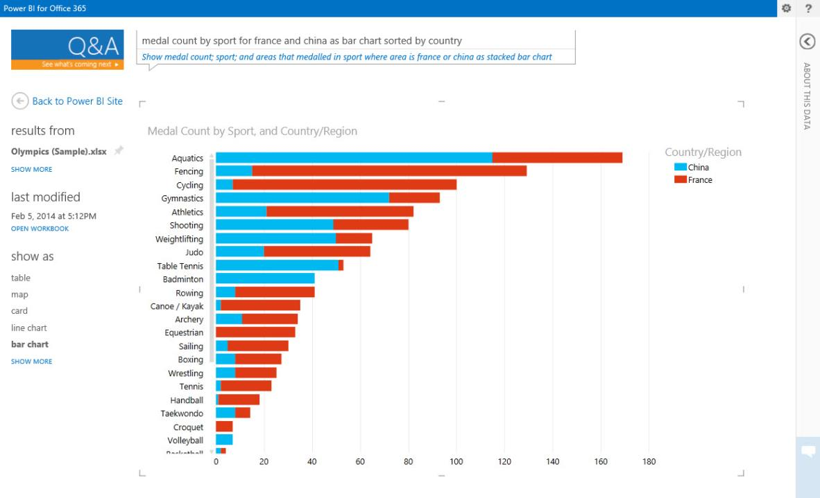
Share & collaborate with Power BI
BI Sites
Ask questions of your data in natural language
Shared Queries
Data Refresh
Data Search
Mobile Access
Natural Language Questions
Notes:
Power BI enables business users to interact with their data in natural language. The natural language query capability allows users to ask questions of their corporate data and get instant and visual results. The experience is instantaneous and uses natural language query. Q&A interprets the semantics of the question the user is asking and serves up the correct interactive chart or graph.
It’s as easy as going to a colleague to ask a question. This dramatically increases how many business users can get more value from their existing BI solutions.

Slide 37
Share and collaborate with Power BI for Office 365
What is Power BI?
Power BI is a business analytics solution that lets you visualize your data and share insights across your organization, or embed them in your app or website.
Connect to hundreds of data sources and bring your data to life with live dashboards and reports.
PowerBI - WATCH OVERVIEW
POWERBI - WATCH DEMO
Available from: https://powerbi.microsoft.com/en-us/what-is-power-bi/
Demo
Notes:
SUGGESTED DEMO: https://powerbi.microsoft.com/en-us/what-is-power-bi/
DEMO ASSETS:
BI Demo Catalog
https://microsoft.sharepoint.com/teams/BIDemoCatalog/SitePages/BI%20Demo%20List.aspx
Launch in a Box
http://infopedia/Pages/EventMaterials.aspx > select ‘Demos’ on the left-hand sidebar
SUGGESTED DEMO:
Ensure you have logged in and navigated to your Power BI site and that the setup workbook (AW Sales Analysis Demo1) has been uploaded to the Power BI site.
Show that the same features are available but the PowerView sheets (Salesperson Sales, Sales by Country) can be viewed in HTML5 (Link bottom right hand side) which is good for Mobile and Tablets

Slide 38
A powerful new way to work with data
Analyze in Excel
Collaborate in Power BI
Discover
Search, access, and transform public and internal data sources with Power Query
Share
Share data views and workbooks refreshable from on-premises and cloud based data sources, with Power BI Sites
Analyze
Easy data modeling and lightning fast in-memory analytics with Power Pivot
Question
Ask questions and get immediate answers with natural language query
Q&A
Visualize
Bold new interactive data visualizations with Power View and Power Map
Mobility
Mobile access through HTML5 and touch optimized apps
Scalable | Manageable | Trusted
Notes:
To summarize – Microsoft is making data and analytics truly accessible by bringing these capabilities directly to the tools that people use every day.
With both Excel and Power BI for Office 365, you can give everyone in your organization a powerful new way to work with data. In Excel, you can now discover, analyze, and visualize data like never before to find valuable business insights. With Power BI for Office 365 you can easily deploy a cloud-based BI environment for users to share insights, collaborate and access reports, from anywhere.

Slide 39

Your Power BI Journey
BI modelling techniques
BI Modelling Techniques

Slide 40
Your Power BI Journey
BI modelling techniques
Integrating data
Integrating Data

Slide 41
Your Power BI Journey
BI modelling techniques
Data Analytics
Integrating Data
Data Analytics

Slide 42
Your Power BI Journey
BI modelling techniques
Design a report
Integrating Data
Data Analytics
Design a report

Slide 43
Your Power BI Journey
BI modelling techniques
Publish report
Integrating Data
Data Analytics
Design a report
Publish a report

Slide 44
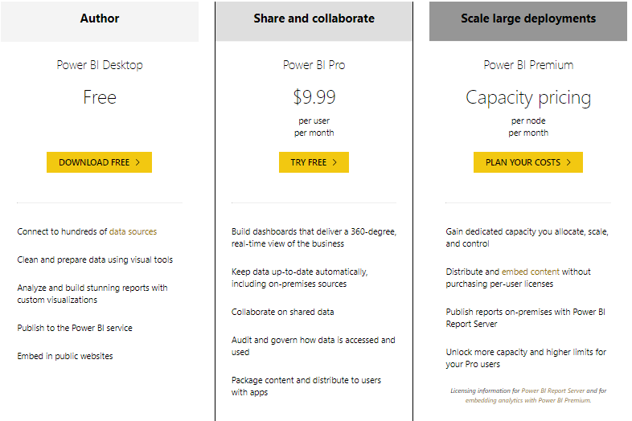
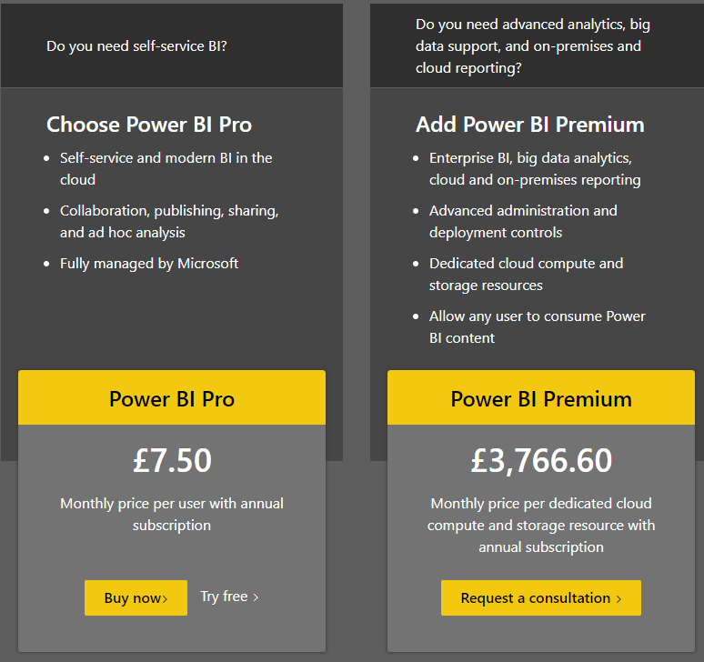

Slide 45
Power BI – Quick Demo
Remember to use appsanywhere, if you are working on a lab machine.
Your tutor will be happy to give you more details in the lab sessions.

Slide 46
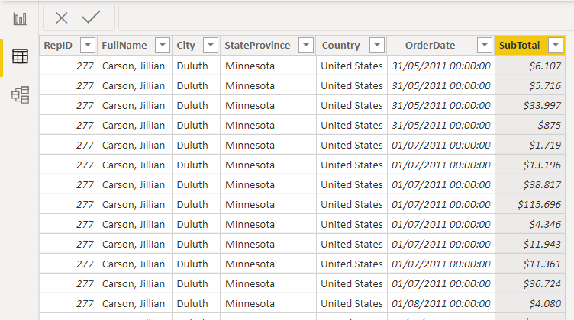
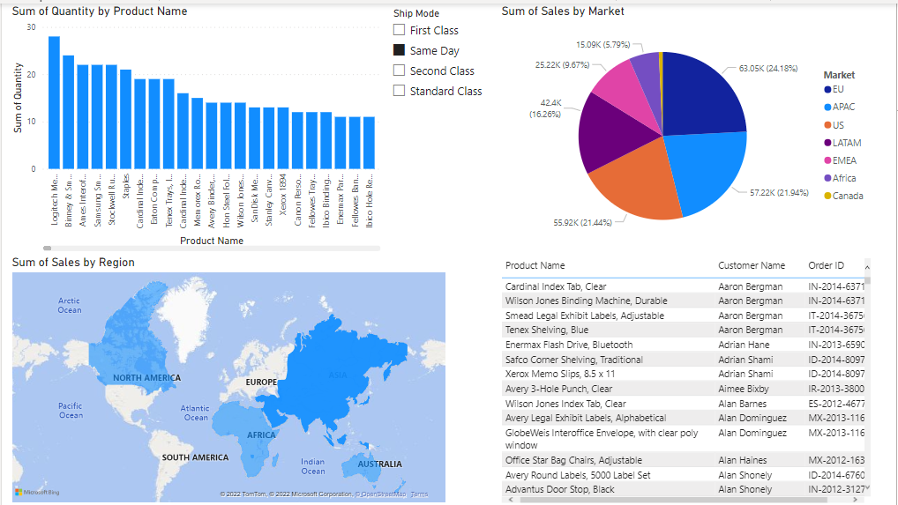
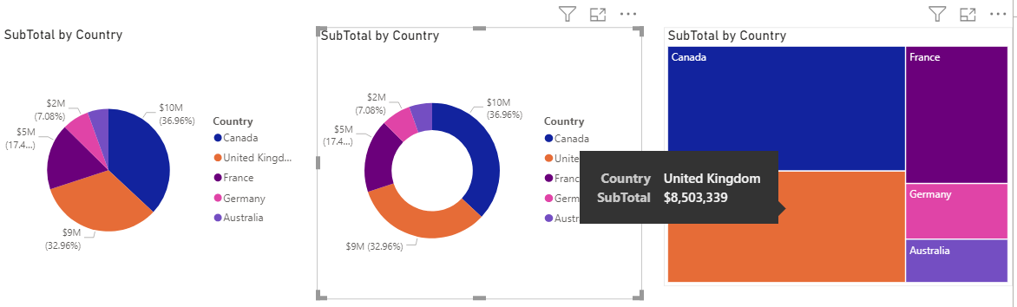
From Excel data to BI Solutions in a few steps!

Slide 47
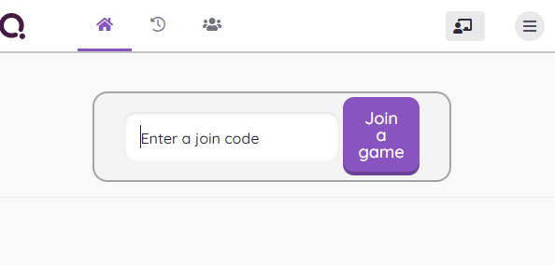
A quick online quiz!
Use the link below to join the online quiz
https://quizizz.com/join
Or simply google “”Quizziz enter code”
And enter
The code on the screen
Notes:
https://quizizz.com/join/quiz/632c2c3409790e001d7c4aa7/start?studentShare=true

Slide 48
ICA Briefing and ICA Sample
See link on Blackboard (Assessments)

Slide 49
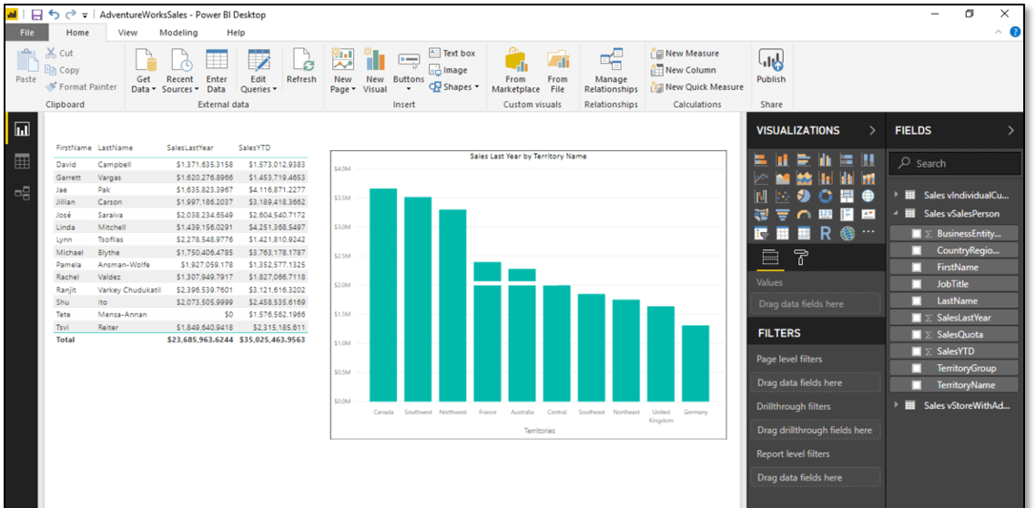
Module Outcome
Develop Business Intelligence solutions to support the information needs of your organisation using Power BI.

Slide 50

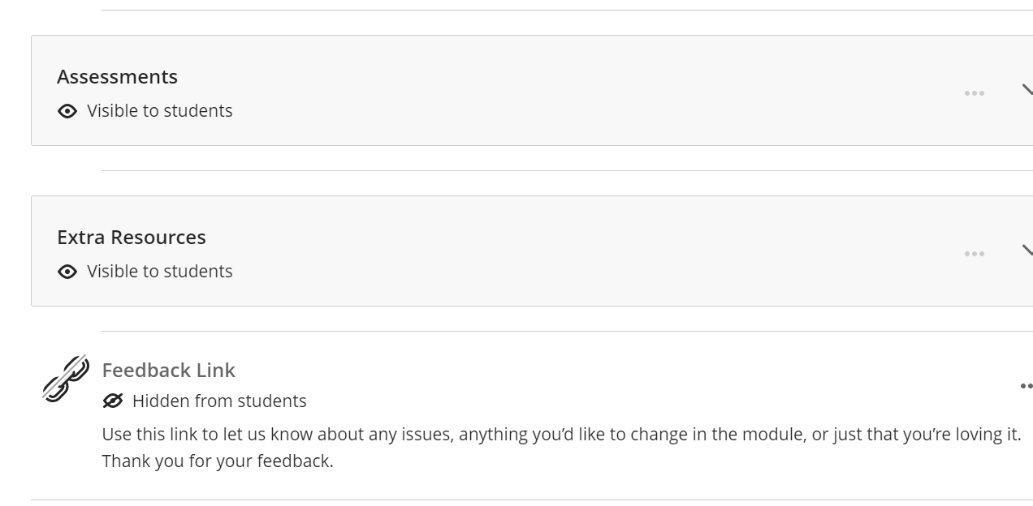
Questions?
We’d love to hear your feedback!
Use the link on BB to let us know about any issues, anything you’d like to change in the module, or just that you’re loving it!

